Slide 1
Generating Breast Cancer IHC Images with Deep Learning
July 23, 2024
Yuchen Li
Xichu Yu
Maiqi Zhou

Slide 2
Contents
Review
Related Work
Methods
Results
Task Distribution
Timeline
Discussion

Slide 3
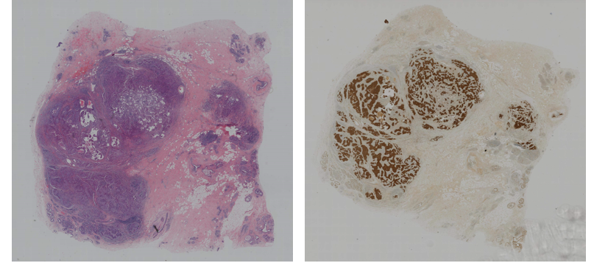
Overview of Initial Proposal
Breast Cancer: A Global Challenge
Breast cancer remains a leading cause of mortality among women worldwide
Effective treatment and accurate diagnosis rely heavily on detailed analysis of histopathological images
Histopathological Images
Hematoxylin and Eosin (HE) and Immunohistochemistry (IHC) stained slices are critical in evaluating breast cancer
An example of HE and IHC stained images
Source: "Breast Cancer Immunohistochemical Image Generation Challenge." grand-challenge.org. https://bci.grand-challenge.org/ (accessed May. 1, 2024)

Slide 4
Overview of Initial Proposal
Challenges with IHC Staining:
The preparation of IHC-stained sections is time-consuming and expensive
IHC staining is typically performed on a single pathological slice, which may not fully represent the status of tumors. HER2 expression level that is diagnosed as 2+ requires further tissue sample
To improve breast cancer diagnosis, we propose training a deep-learning model
This model will perform image-to-image translation from the HE domain to the IHC domain, reducing costs and enhancing diagnostic efficiency
The model will be integrated into existing diagnostic software, enabling adoption in clinical settings

Slide 5
Related work

Slide 6
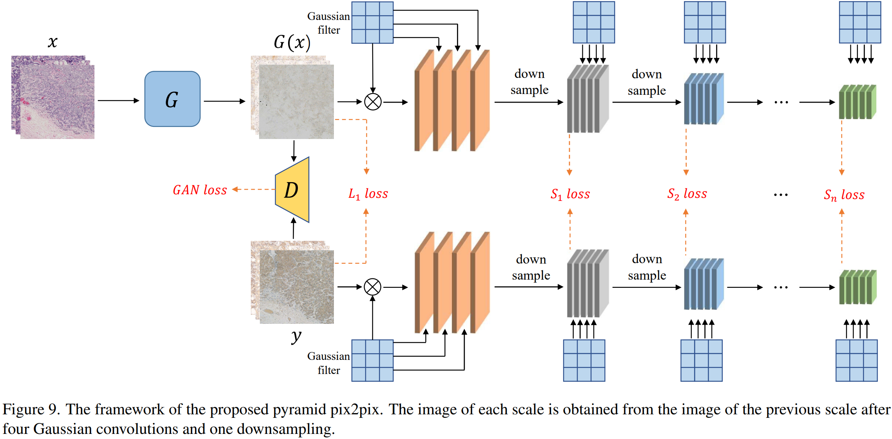
Pyramid pix2pix
Figure: Pyramid pix2pix architecture proposed by the challenge organizer.
a type of conditional Generative Adversarial Network (cGAN)
multiple Gaussian convolutions
downsampling the smoothed image to reduce its resolution and eliminate redundant pixels
Source: Liu et al. "Bci: Breast cancer immunohistochemical image generation through pyramid pix2pix." In *Proceedings of the IEEE/CVF conference on computer vision and pattern recognition*, pp. 1815-1824. 2022.

Slide 7
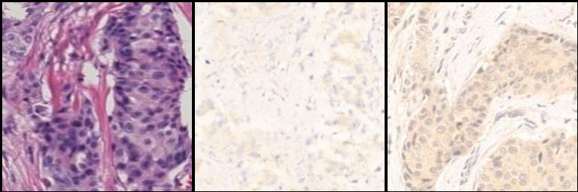
Results
train locally for 100 epochs with 256x256 images
Real A
Fake B
Real B

Slide 8
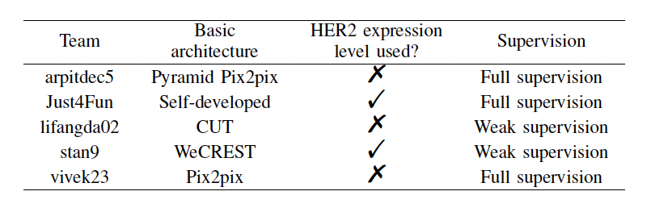
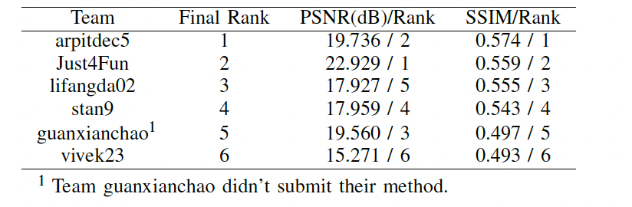
Review of BCI Challenge
Source: Liu et al. "Bci: Breast cancer immunohistochemical image generation through pyramid pix2pix." In *Proceedings of the IEEE/CVF conference on computer vision and pattern recognition*, pp. 1815-1824. 2022.

Slide 9
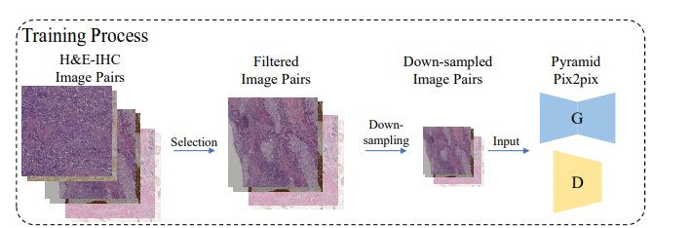
Review of BCI Challenge
team: arptidec5
model: Pyramid pix2pix
extended method: filter the image pairs in the dataset, about 10%
went through a quality control process to ensure images with artifacts, cracked tissue, or blurriness were removed
Source: Liu et al. "Bci: Breast cancer immunohistochemical image generation through pyramid pix2pix." In *Proceedings of the IEEE/CVF conference on computer vision and pattern recognition*, pp. 1815-1824. 2022.

Slide 10
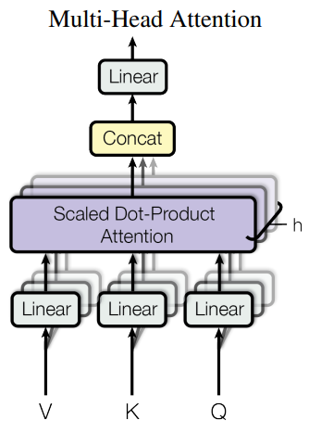
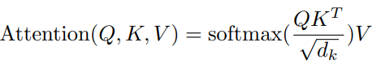
Attention mechanism
consider the global information
selectively focus on important feature
Vaswani, A., Shazeer, N., Parmar, N., Uszkoreit, J., Jones, L., Gomez, A. N., ... & Polosukhin, I. (2017). Attention is all you need.

Slide 11
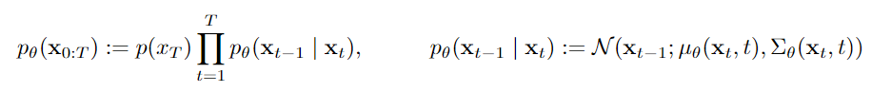
Diffusion Probabilistic Model
Reverse process:
Forward process:
Noise schedule ꞵ gradually increasing
Forward process fixed to a Markov chain
Gaussian noise added to the input
Ho et al. "Denoising diffusion probabilistic models." Advances in neural information processing systems 33 (2020): 6840-6851.
Notes:
The Diffusion Probabilistic Model is a type of generative model that involves two main processes: the reverse process and the forward process. The reverse process involves starting from a simple distribution p(x_T) and iteratively sampling from pθ(xt−1∣xt) to generate samples from the target distribution. The forward process involves progressively adding Gaussian noise to an initial data point x_0​ to obtain a sequence of increasingly noisy samples x_{1:T}

Slide 12
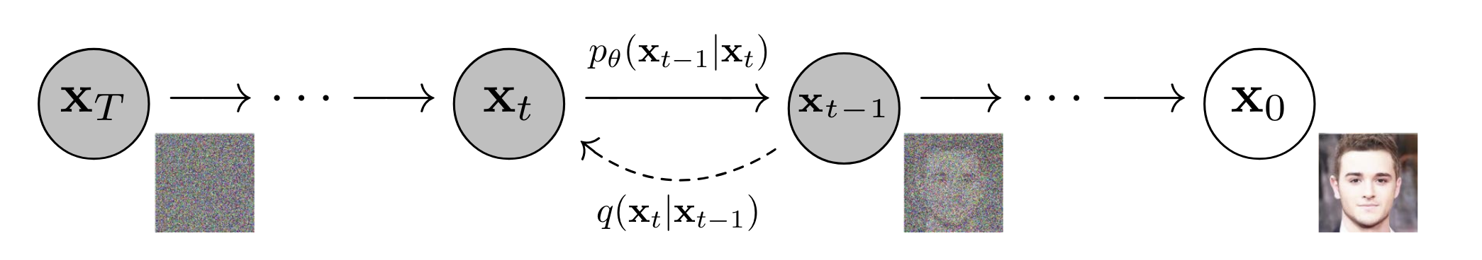
DDPM (Denoising Diffusion Probabilistic Models)
Forward Process: Gaussian noise progressively added to an input sample
Reverse Process: Reconstructing the original data sample
Utilize neural network to predict the noise added in each step
Simplified training objective
Ho et al. "Denoising diffusion probabilistic models." Advances in neural information processing systems 33 (2020): 6840-6851.

Slide 13
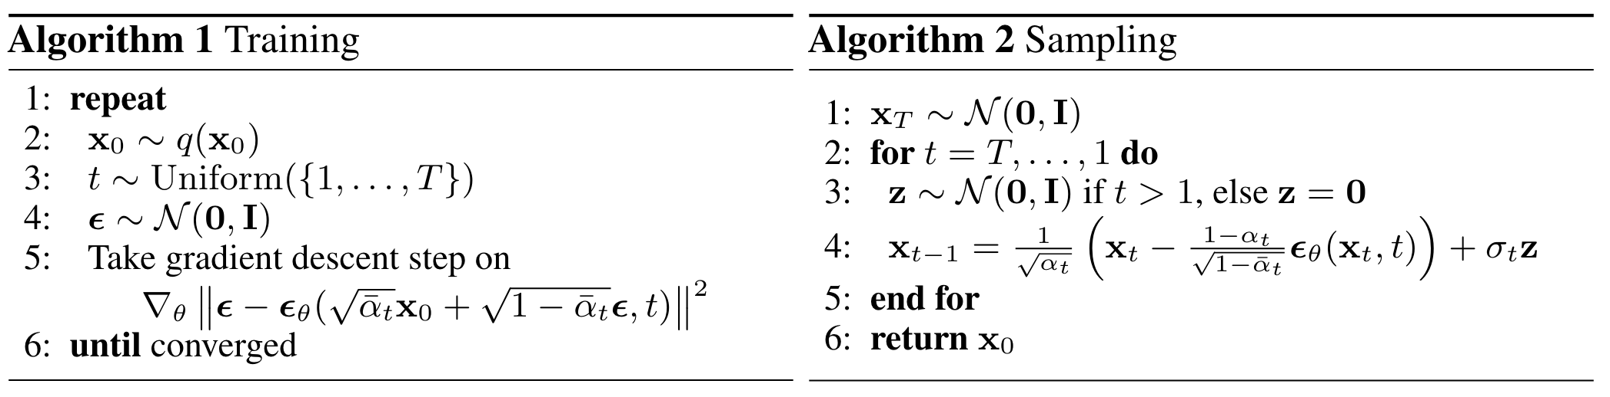
Basic algorithms for DDPM
Training objective:
Minimizing the mean squared error (MSE) of noise prediction for given timestep T
Ho et al. "Denoising diffusion probabilistic models." Advances in neural information processing systems 33 (2020): 6840-6851.

Slide 14
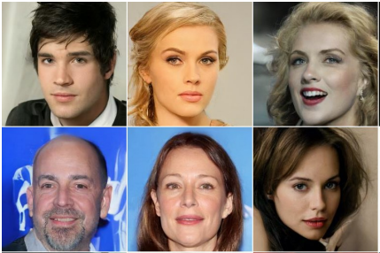
Discussion on DDPM
High-quality
Diverse output
Probabilistic, reverse process draws from Gaussian distribution
Low sample efficiency due to large sample steps
Samples from DDPM
Ho et al. "Denoising diffusion probabilistic models." Advances in neural information processing systems 33 (2020): 6840-6851.

Slide 15
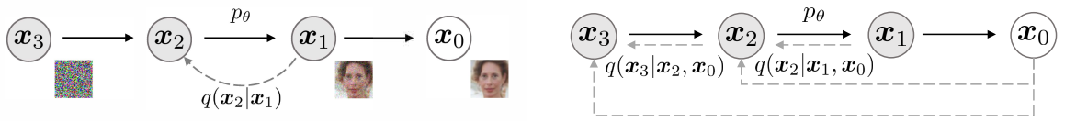
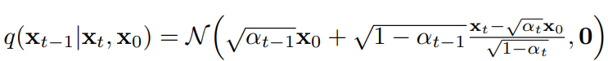
Denoising Diffusion Implicit Model (DDIM)
Reverse sample in DDIM:
Deterministic, no variance
Significantly reduce the number of sampling steps
Song, Jiaming, et al. "Denoising Diffusion Implicit Models." ArXiv, 2020

Slide 16
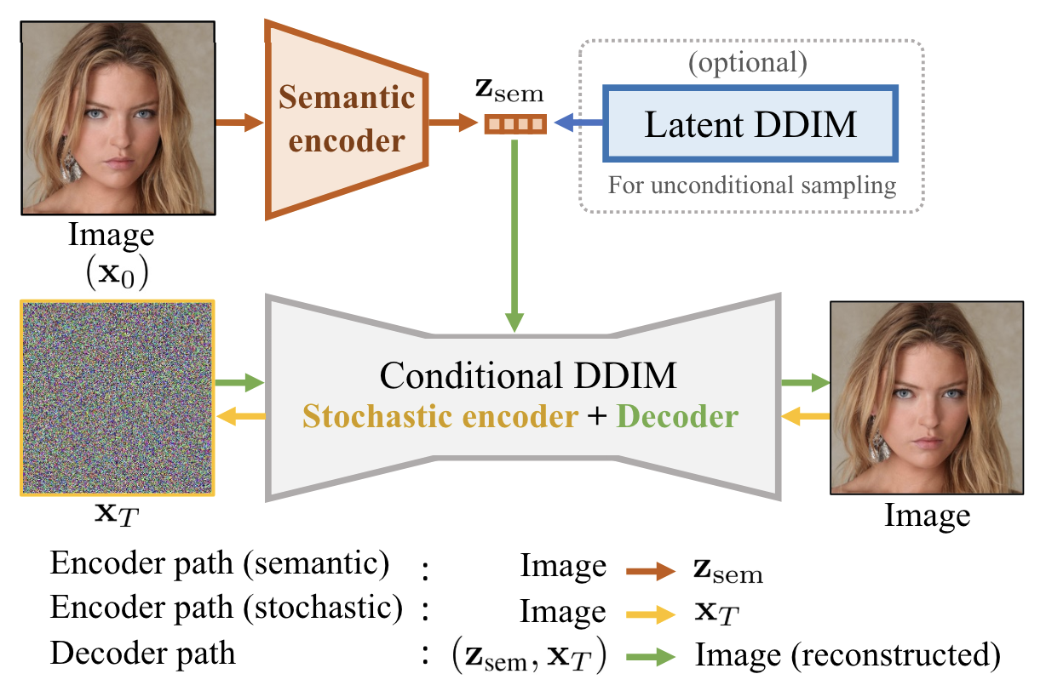
Diffusion Autoencoder
Hybrid model combining autoencoders and diffusion principles
Encoding input into a low-dimensional latent space, applying diffusion process, and decoding back
Additional semantic encoder to guide the diffusion process

Slide 17
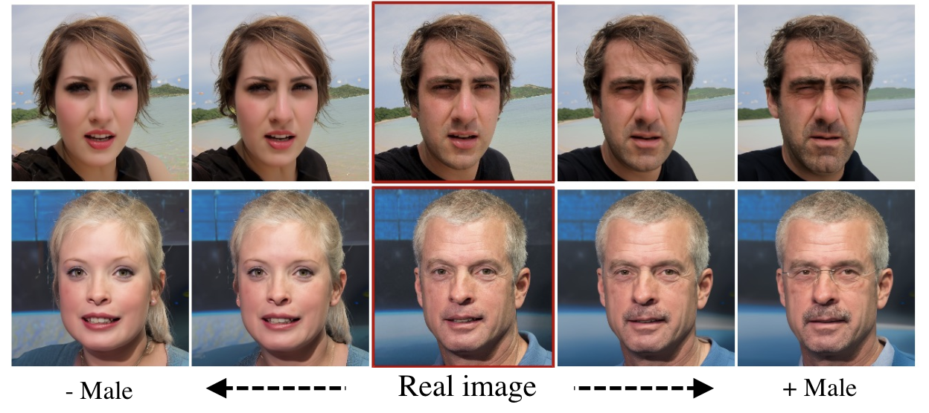
Diffusion Autoencoder
Example of attribute manipulation based on latent interpolation

Slide 18
Methods

Slide 19
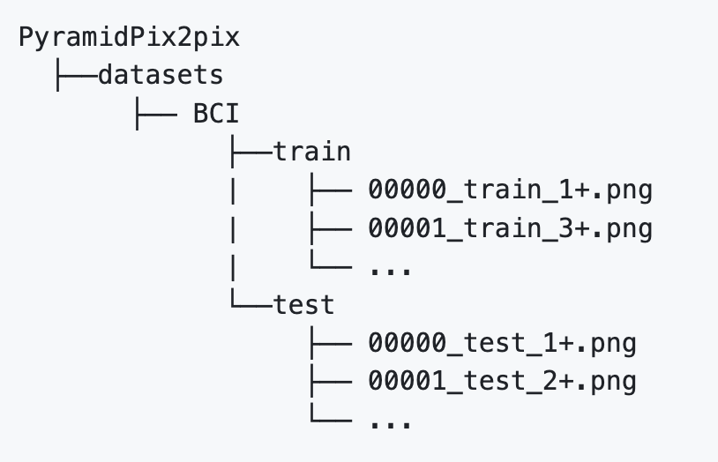
Dataset
Officially available Breast Cancer Immunohistochemical (BCI) dataset
Contains 9,746 images (4,873 pairs, 3897 pairs for training)
Already divided into training set and test set
Source: [Bupt AI CZ's BCI Project on GitHub](https://github.com/bupt-ai-cz/BCI)

Slide 20
Dataset Preprocessing
Tool: HistoQC
an open-source software to filter out low-quality images
Filtering Standards:
Flat Areas:
detects smooth (flat) areas in an image by convolving the image with an average filter and comparing it to the original image
Small Tissue Filled Max Area:
sets the upper limit on the size of holes that should be filled within the tissue mask
Blurry Removed Num Regions:
represents the number of regions (or areas) within an image that has been removed due to being identified as blurry

Slide 21
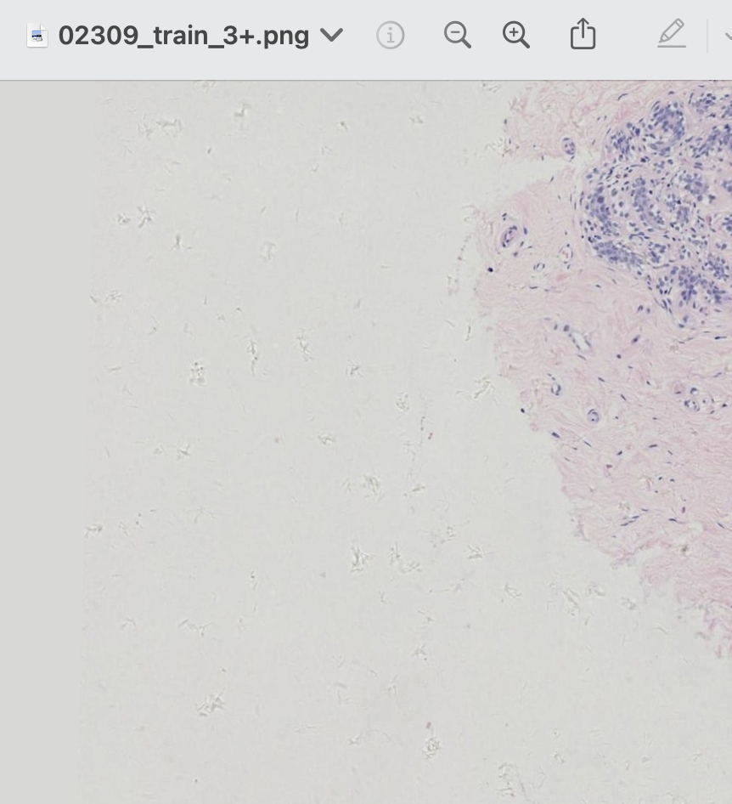
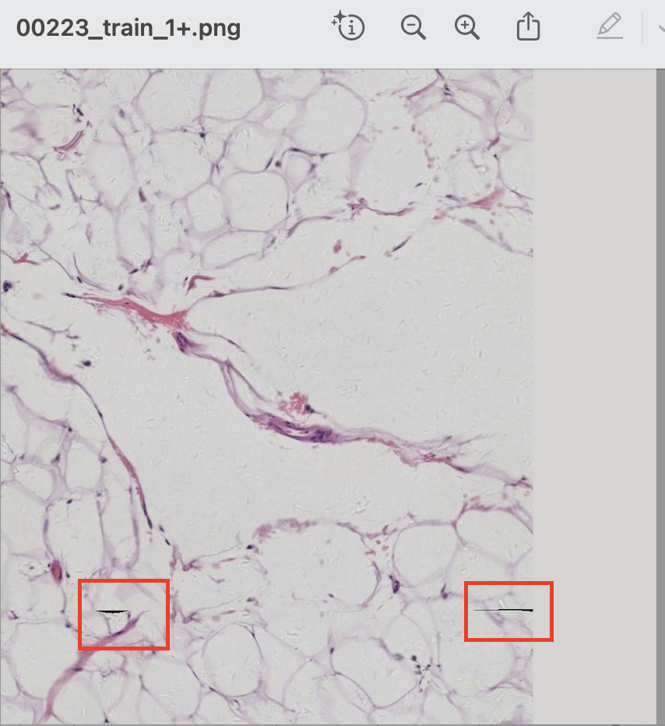
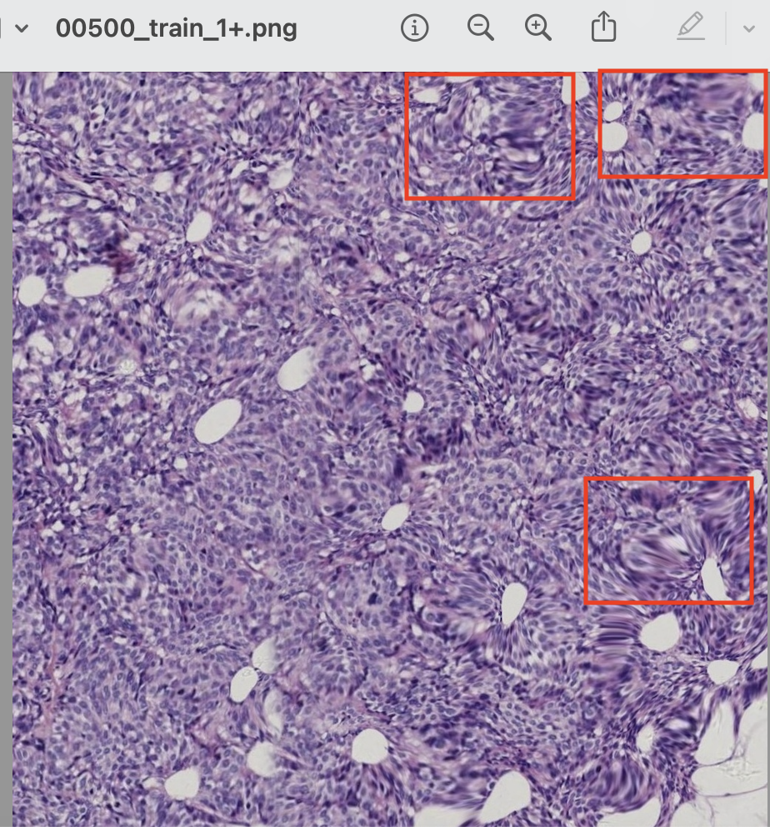
Dataset Preprocessing
Flat Areas:
Small Tissue Filled Max Area:
Blurry Removed Num Regions:

Slide 22
Dataset Preprocessing
Experiment 1:
Filtering Standards:
small_tissue_filled_max_area> 100 & blurry_removed_num_regions > 1
100 epochs on Pyramid Pix2pix with 256*256 images
Original Pairs | After preprocessing Pairs | Filter Rate
3897 | 3656 | 6.19%

Slide 23
Dataset Preprocessing
Experiment 2:
Filtering Standards:
small_tissue_filled_max_area > 100 & flat_areas > 3
100 epochs on Pyramid Pix2pix with 256*256 images
Original Pairs | After preprocessing Pairs | Filter Rate
3897 | 3722 | 4.49%

Slide 24
Dataset Preprocessing
Results:
 | PSNR | SSIM
original | 17.46 | 0.59
filtered 1 | 19.23 | 0.61
filtered 2 | 17.53 | 0.57

Slide 25
Pix2Pix Model(U-Net)

Slide 26
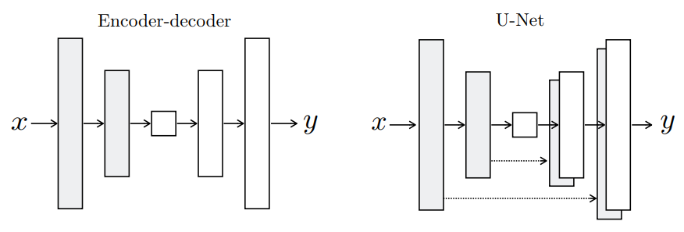
Model Design
Generator: U-Net
Downsampling section (encoder): 8 downsampling blocks
Upsampling section (decoder): 8 upsampling blocks
Skip connection
Final output layer: A 3x3 Conv layer Loss: Adversarial Loss + L1 loss
Discriminator: PatchGan
Conv layer 1: A 3x3 Conv layer
3 downsampling blocks
Final output layer: A 4x4 Conv layer
Loss: Binary Cross Entropy Loss
Isola, Phillip, et al. "Image-to-image translation with conditional adversarial networks." Proceedings of the IEEE conference on computer vision and pattern recognition. 2017.

Slide 27
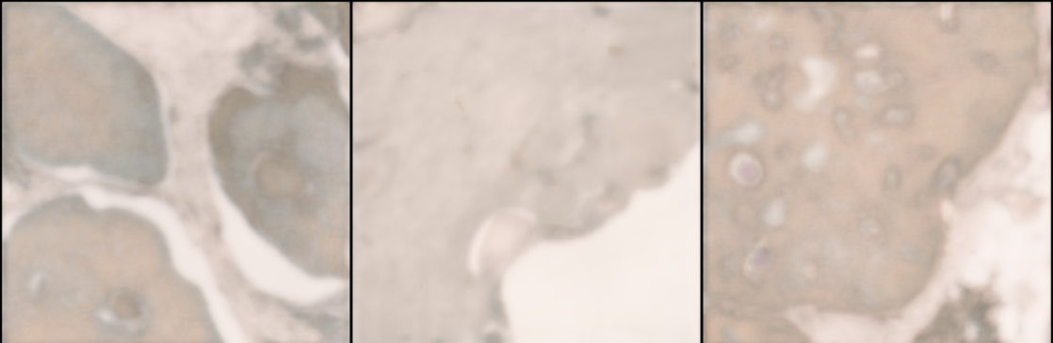
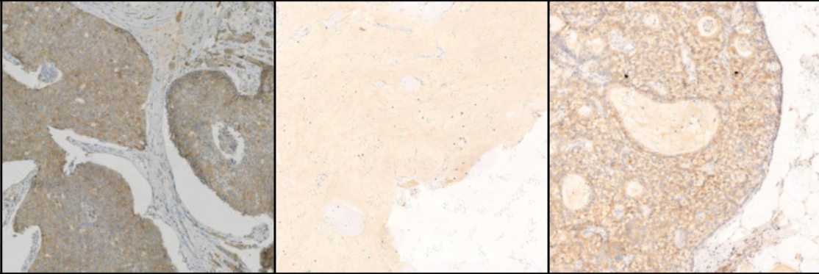
Results
Fake IHC image
Real IHC image
lack of detail
lack of clarity

Slide 28
Pix2Pix Model(TransUnet)

Slide 29
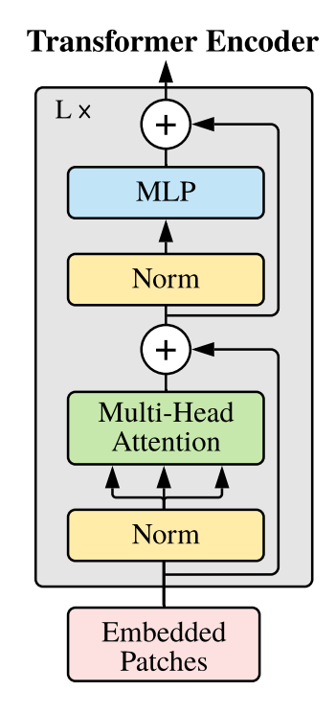
Model Design
Generator: TransUnet
Encoder: Residual blocks from pretrained ResNet-50
Transformer layer: Pretrained Vision Transformer model
Decoder: 8 upsampling blocks
Final output layer: A 3x3 Conv layer Loss: Adversarial Loss + L1 loss
Discriminator: PatchGan
Conv layer 1: A 3x3 Conv layer
3 downsampling blocks
Final output layer: A 4x4 Conv layer
Loss: Binary Cross Entropy Loss
Dosovitskiy, A., Beyer, L., Kolesnikov, A., Weissenborn, D., Zhai, X., Unterthiner, T., ... & Houlsby, N. (2020). An image is worth 16x16 words: Transformers for image recognition at scale.

Slide 30
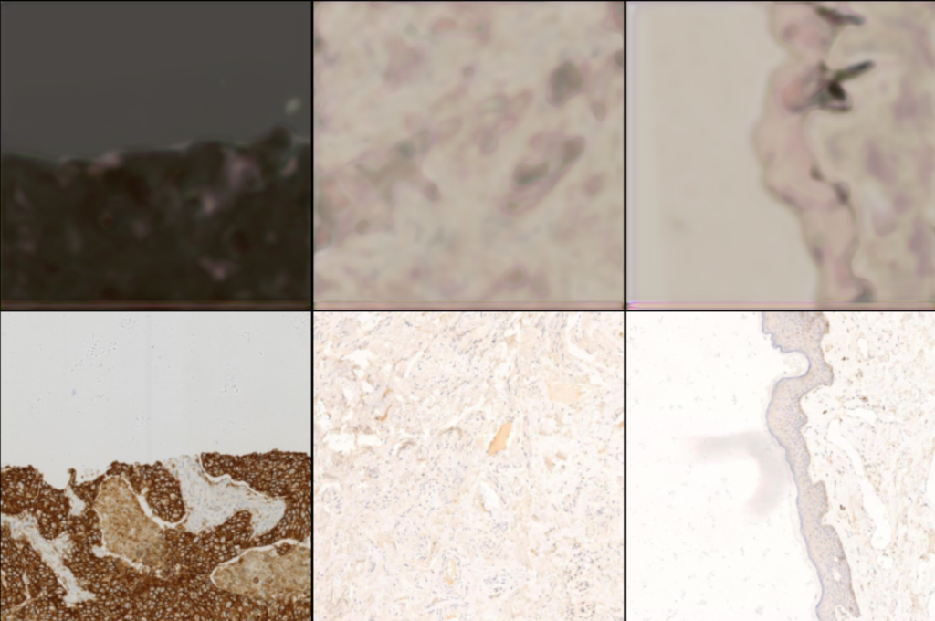
Results
Fake IHC image
Real IHC image
blurred
lack of detail
Notes:
ResNet 50 is a pretrained using for image segmentation, so it not suit for image translation. improve: fine-tune

Slide 31
Pix2Pix Model(Attention U-Net)

Slide 32
Model Design
Generator: Attention U-Net
Encoder: 8 downsampling blocks
Decoder: 8 upsampling blocks
Attention Blocks: At each skip connection
Final output layer: A 3x3 Conv layer Loss: Adversarial Loss + L1 loss/ Adversarial Loss + L1 loss + VGG loss
Attention Blocks:
Input transform: two feature maps from encoder and decoder: 1x1 Conv layer
Combination: Combine transformed feature maps with element-wise addition
Attention map generation: V, K and Q
Feature modulation:
Vaswani, A., Shazeer, N., Parmar, N., Uszkoreit, J., Jones, L., Gomez, A. N., ... & Polosukhin, I. (2017). Attention is all you need.

Slide 33
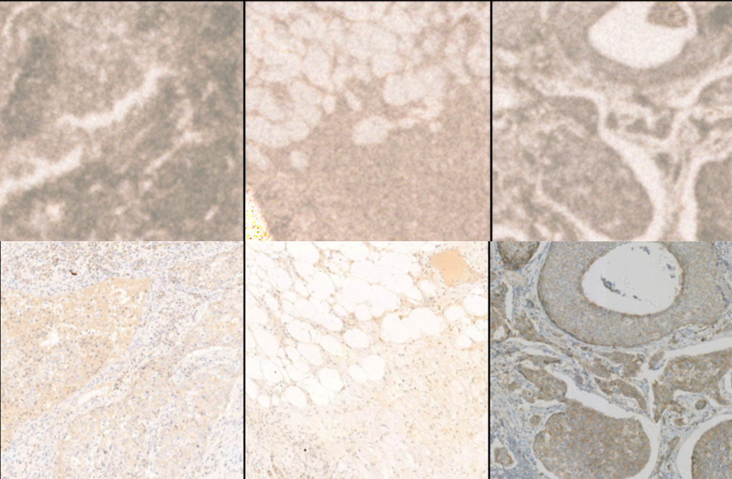
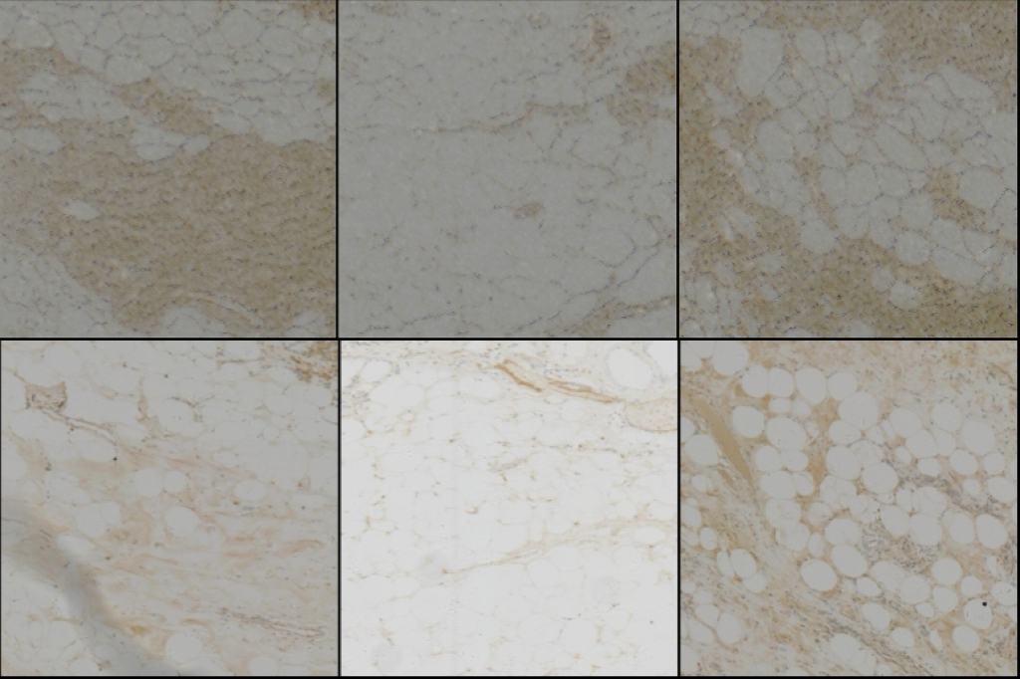
Results
L1 + adversarial loss
L1 + adversarial loss + VGG loss
Fake IHC
Real IHC

Slide 34
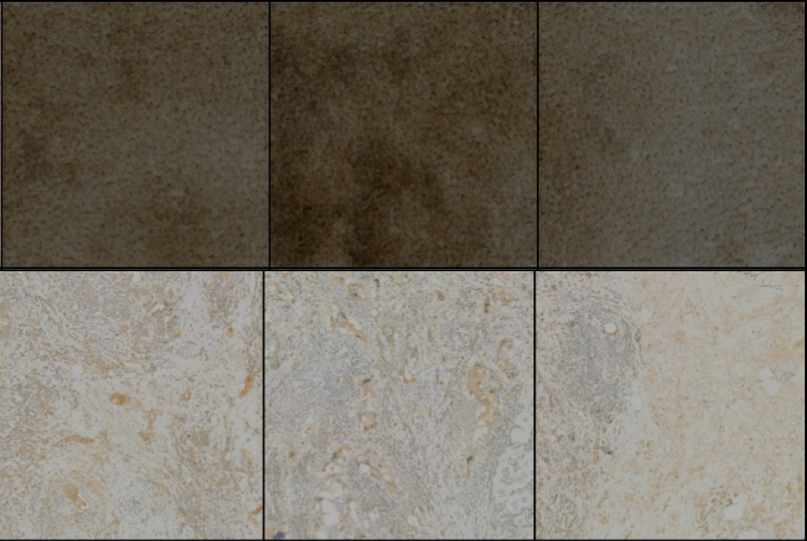
Bad Results
Fake IHC
Attention blocks rely on distinct features to focus on relevant areas.
Real IHC
When the real images lack clear structural details, model fails to effectively enhance relevant features, leading to poor output quality.

Slide 35
Evaluation Metrics
Learned Perceptual Image Patch Similarity (LPIPS):
quantifies the perceptual differences between two images by leveraging deep learning models to approximate human visual sensitivity to various image distortions.
Peak Signal-to-Noise Ratio (PSNR):
is a traditional, widely utilized metric in the field of image processing for assessing the quality of reconstructed images. PSNR measures the ratio between the maximum possible power of a signal and the power of corrupting noise that affects its fidelity, expressed in decibels.
The Structural Similarity Index (SSIM):
is an advanced metric designed to improve upon traditional methods like PSNR by taking into account the perceived changes in structural information, luminance, and contrast of an image.

Slide 36
Evaluation Score
Model | Average LPIPS | Average PSNR | Average SSIM
Pix2Pix (U-Net) | 0.6718 | 17.1238 | 0.3174
Pix2Pix (TransUnet) | 0.7110 | 16.4542 | 0.3032
Pix2Pix (Attention U-Net) | 0.6959 | 6.6879 | -0.0689
Pix2Pix (Attention U-Net) with VGG loss | 0.5697 | 6.3755 | -0.0591
Pyramid pix2pix | - | 21.160 | 0.477

Slide 37
Diffusion Model

Slide 38
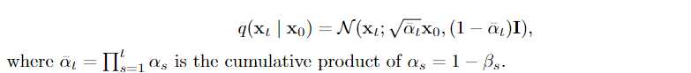
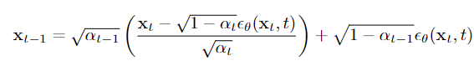
Diffusion process
Followed the principle of DDIM
Deterministic output required for supervised learning task
Higher efficiency
Forward process:
Reverse process:

Slide 39
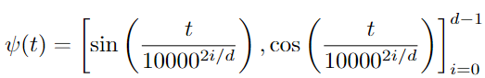
Conditional Mechanisms
Sinusoidal encoding for time step t
Maps timesteps to a higher-dimensional space (sinusoidal curves of varying frequencies) to capture relationships in the data
Followed previous works on diffusion models
Naively: concatenation with input, used in preliminary experiments

Slide 40
Conditional Mechanisms
Naive conditioning: concatenation of two images
6-channel input and 3-channel output

Slide 41
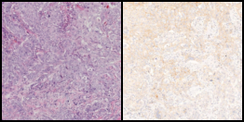

Results of preliminary experiments
Left: Ground truth
Right: Sampled
Naive Conditional diffusion model
Very noisy
Search for alternatives

Slide 42
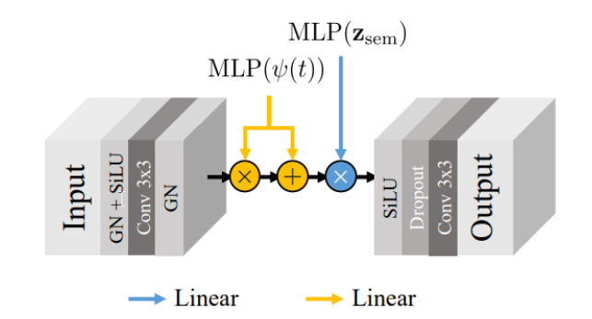
Conditional Mechanisms
AdaGN used in DiffAE
𝜓 is the sinusoidal encoding
Zsem is semantic encoding
MLP denotes multilayer perceptron
Use scale and shift to incorporate the condition information
DiffAE: Encode the target image to encourage reconstruction
Ours: Encode the condition image (HE image) to encourage conversion

Slide 43
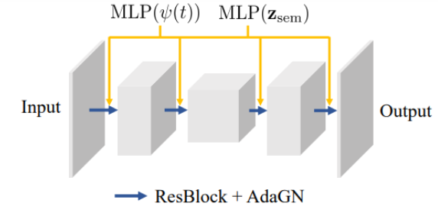
Model architecture
ResBlock + AdaGN followed the DiffAE paper
UNet framework
Attention blocks used in the bottleneck of UNet

Slide 44
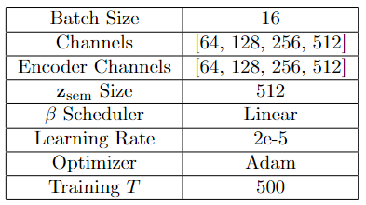
Hyperparameters

Slide 45
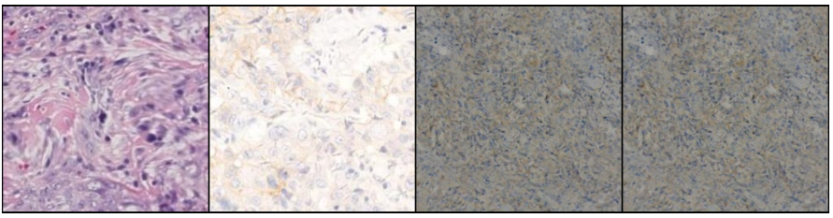
Visual Results
Not noisy
Very low fidelity
Left: Ground truth (HE and IHC)
Right: Sampled

Slide 46
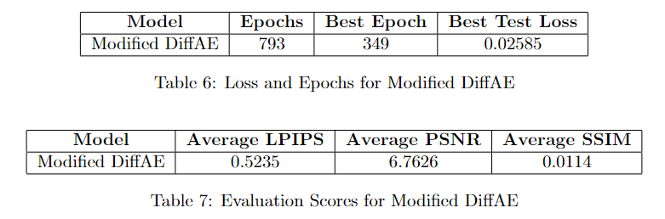
Quantitative Results
Terrible scores, consists with visual results
Fully trained and the test loss appears to be low

Slide 47
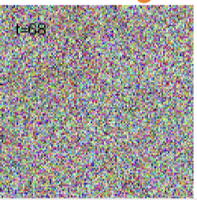
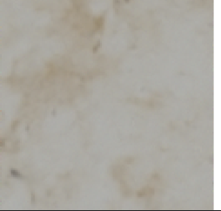
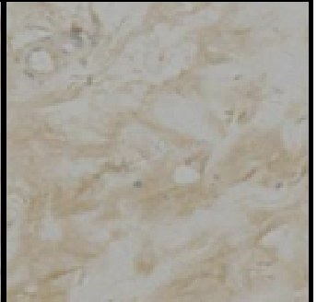
Analysis and Conclusion
Terrible scores, consists with visual results
Fully trained and the test loss appears to be low

Slide 48
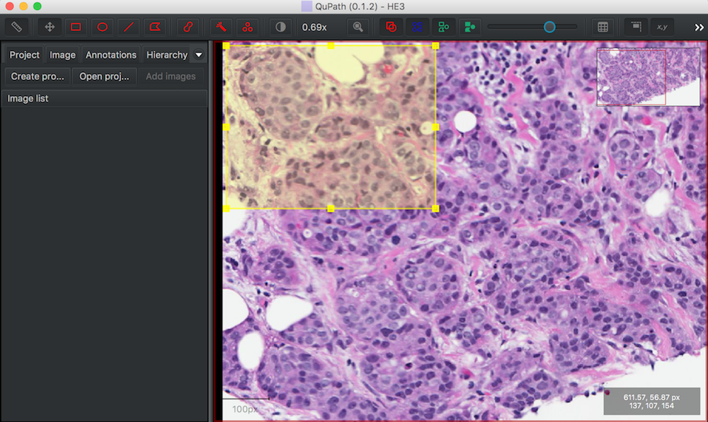
Software Design
QuPath
Open-source pathology image analysis software.
Support customizable extensions.
We plan to develop a python extension that will integrate our model to QuPath with user-friendly functions.
Source: D. Breen, "H&E Histology Color Normalization - QuPath," Drexel University, 2018. [Online]. Available: https://www.cs.drexel.edu/~deb39/ZarellaLab/h-e-histology-color-normalization_qupath.html. [Accessed: 12-May-2024]

Slide 49
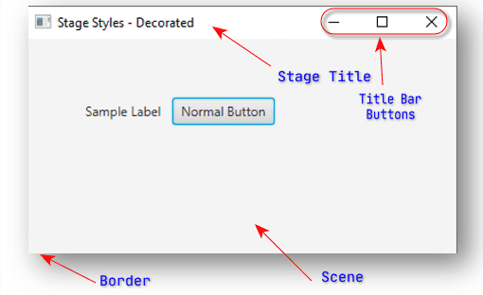
Software Design
JavaFX
A software platform for creating and delivering desktop applications with a modern user interface.
FXML: XML-based language to define UI components (though Java code can also be used directly).
The template of Qupath extension provided imports javafx, making it easy to build complex interfaces.
Source: https://owlcation.com/stem/JavaFx-Stage-Styles[Accessed: 12-June-2024]

Slide 50
Software Design
QuPathExtension Interface
- Integrates with QuPath
- Manages initialization
interface.fxml
- Defines UI layout
Controller
- Handles UI logic and events
JavaFX Platform
QuPath Framework

Slide 51
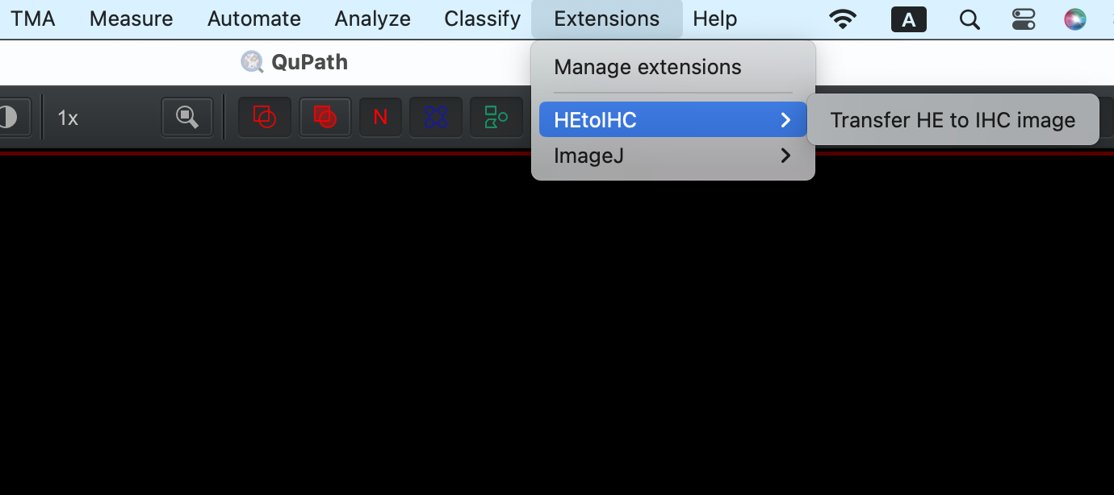
Software Development

Slide 52
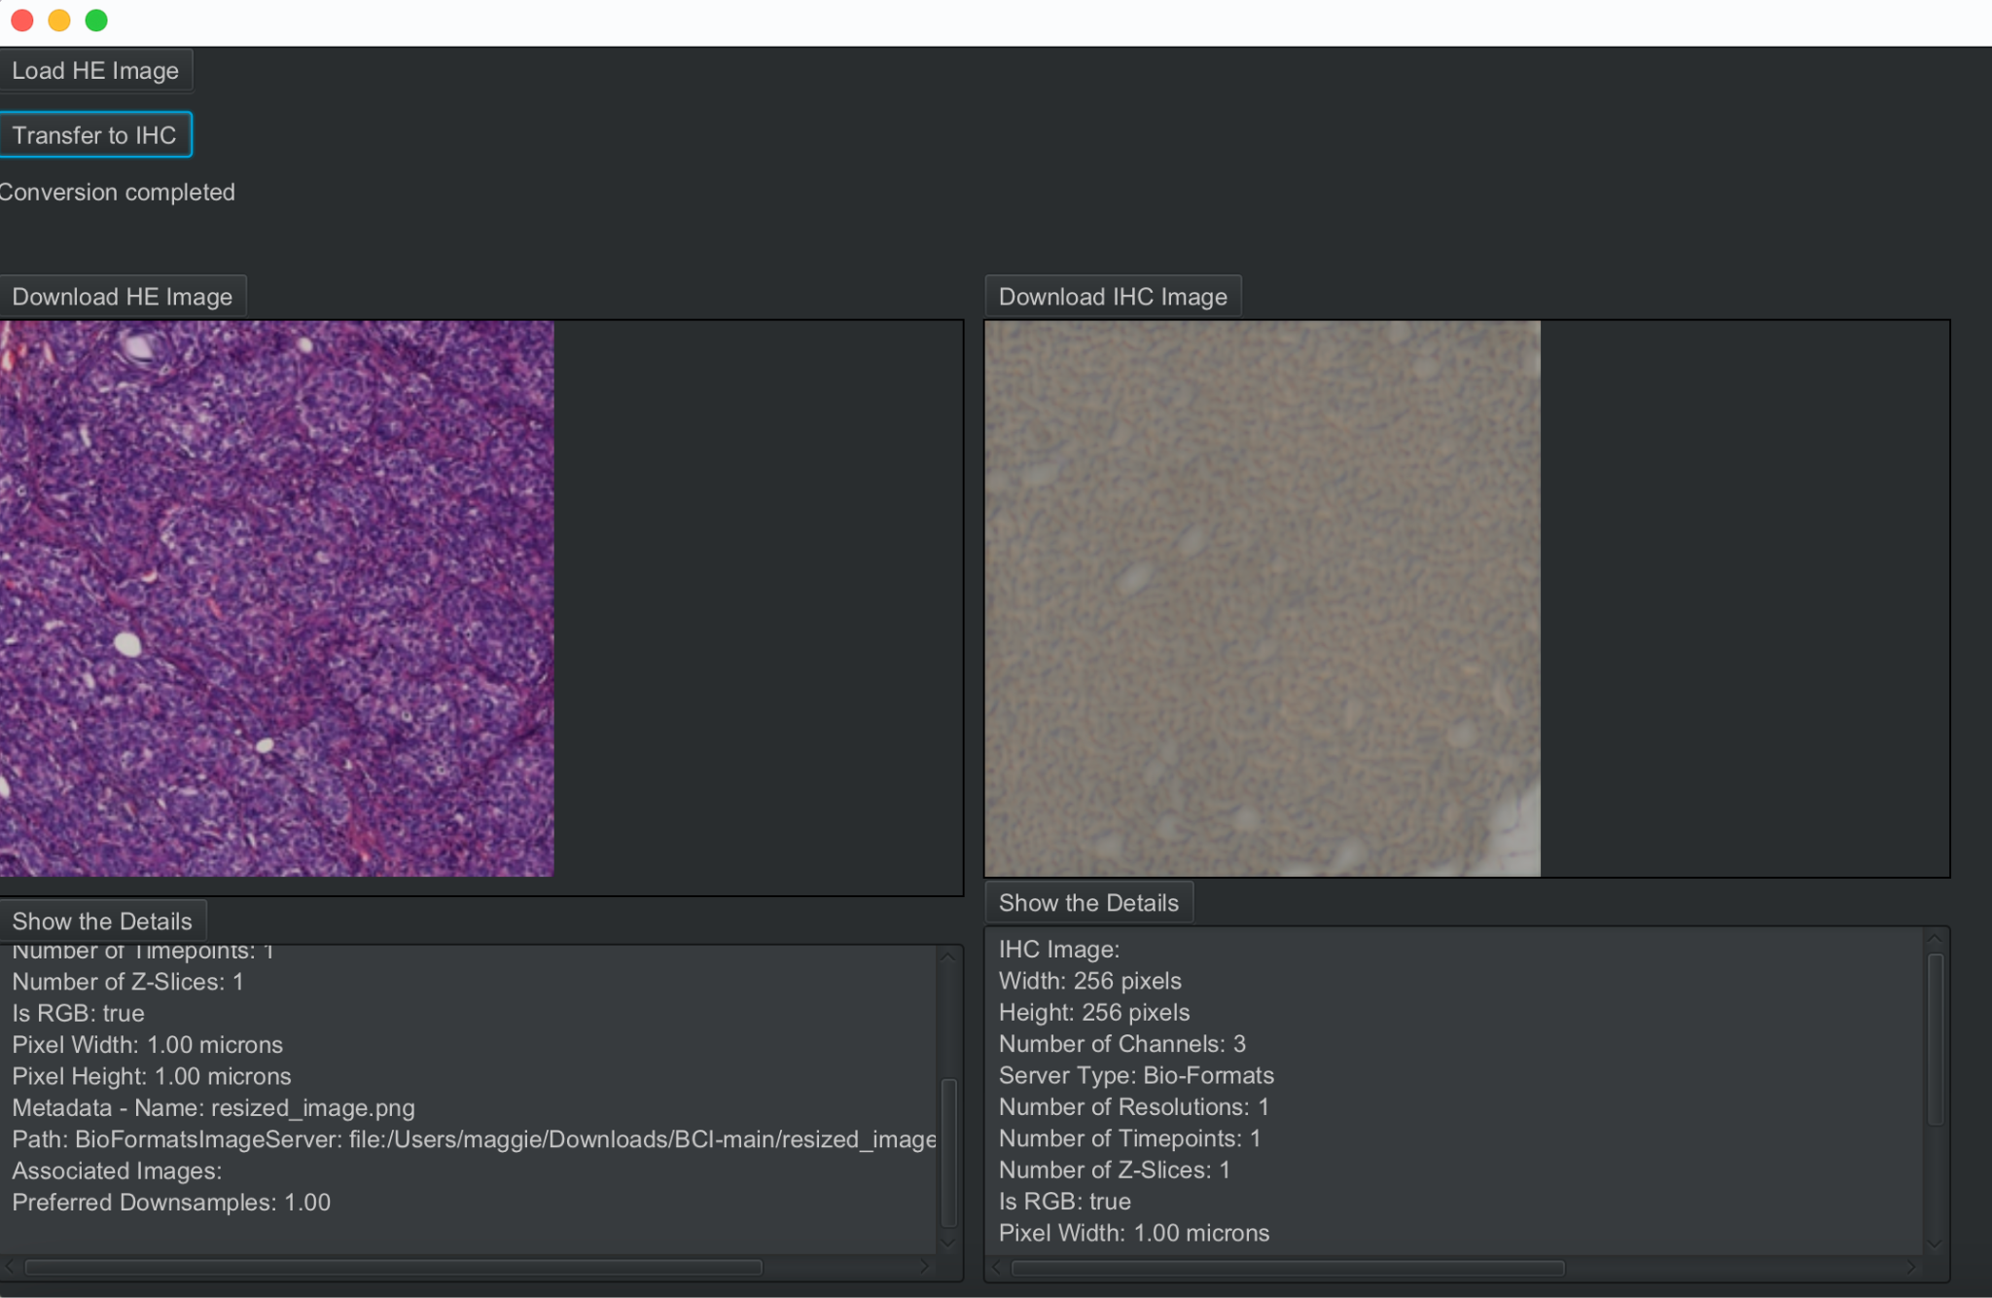
Software Development

Slide 53
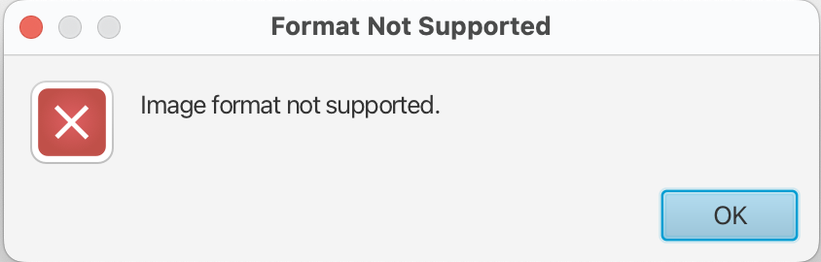
Software Development
Test Case 1: Load an incorrect image format such as .txt

Slide 54

Software Development
Test Case 2: Give an incorrect image path

Slide 55
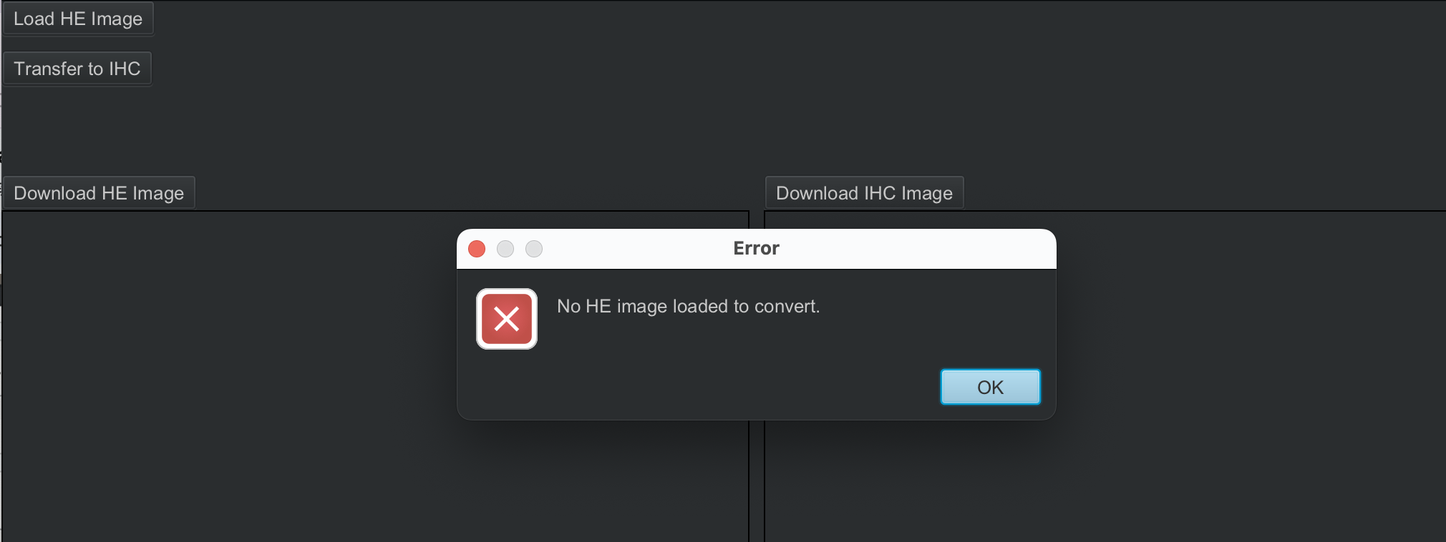
Software Development
Test Case 3: click the transfer button with no HE image

Slide 56
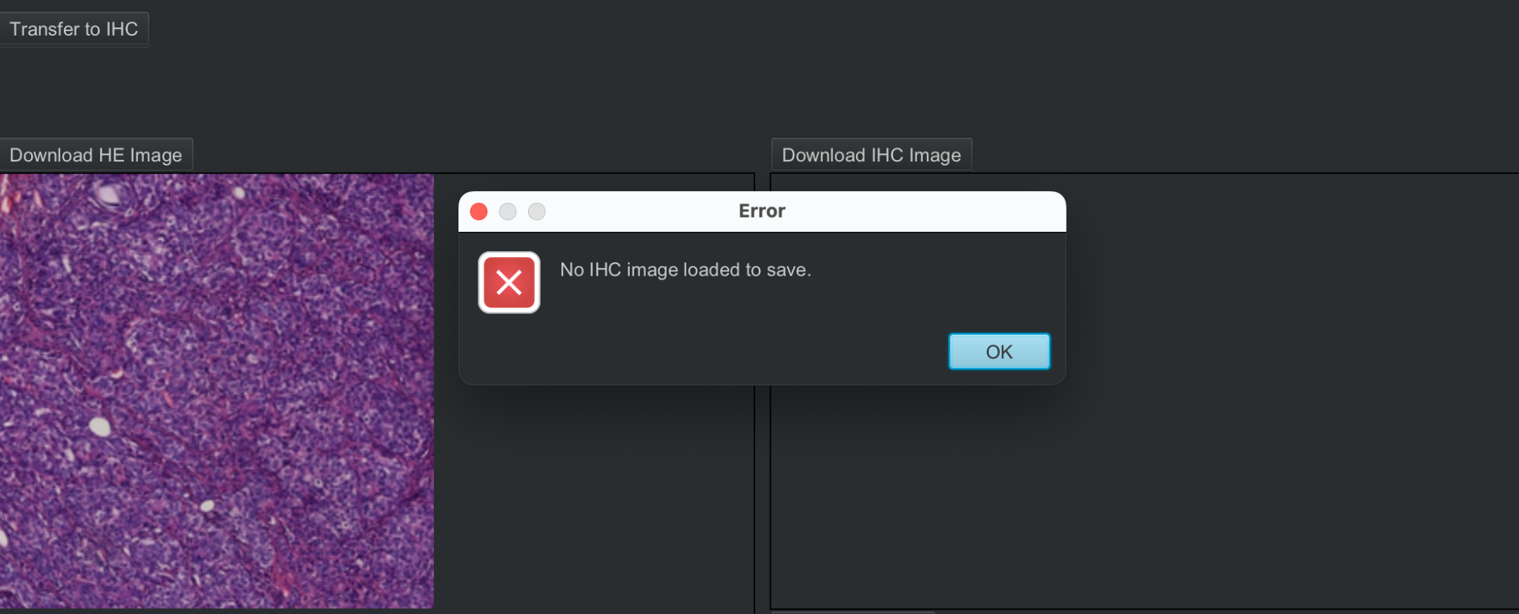
Software Development
Test Case 4: Save the image without loaded

Slide 57
Task distribution
Task | Member
Preprocessing the dataset | Maiqi Zhou
Development of software system | Maiqi Zhou
Pix2Pix Model | Xichu Yu
Model Evaluation | Xichu Yu
Diffusion Models | Yuchen Li
Experimental Design | Yuchen Li

Slide 58

Time schedule

Slide 59
Discussion: Pix2pix and Variant
Current problems:
High noise level
Poor learning ability
Future work:
Applying noise reduction techniques
Refining the implementation of attention blocks
Finding a better combination of loss functions

Slide 60
Discussion: Diffusion Models
Lack of computational resource: Diffusion models require good GPUs (e.g. V100s are required for 128*128 tasks in official DiffAE)
GAN works more implicitly, generate the target image directly
Possible refinements:
Use full DiffAE architecture
Utilize extensions to diffusion models (e.g. autoregressive recurrent neural network (RNN) which is suitable for time series)

Slide 61
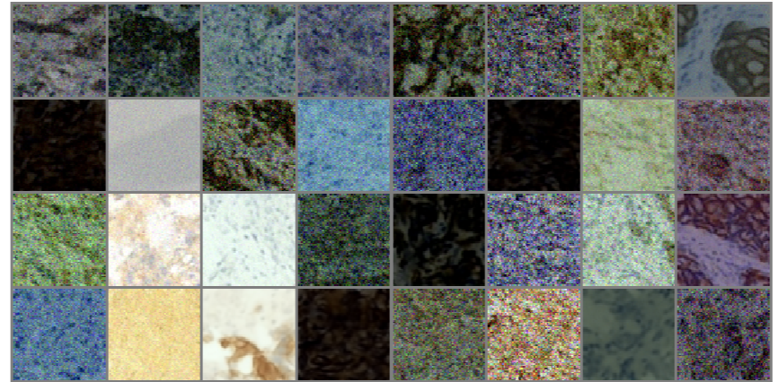
Discussion: Diffusion Models
740k steps on full DiffAE architecture

Slide 62
Discussion: Software System
Current problems:
is isolated by the initial frame of Qupath
can not use the functions of Qupath directly
Future work:
Integration with Qupath Functions:
Develop a middleware or a bridging script that can preprocess data to ensure compatibility with Qupath’s functions. This could involve reformatting the data frames or creating a custom import/export pipeline that maintains the integrity of the data while ensuring it is compatible with Qupath.

